Slide 1
Exploratory Data Analysis-1 (EDA-1)
Data Cleaning,
Imputation Techniques,
Data Analysis and Visualization(Scatter Diagram, Correlation Analysis),
Transformations
Auto EDA libraries

Slide 2
EDA
1) Describe a dataset: Number of rows/columns, missing data, data types, preview.
2) Clean data : Handle missing data, invalid data types, incorrect values and outliers
3) Visualize data distributions: Bar charts, histograms, box plots.
4) Calculate and visualize: Correlations (relationships) between variables, Heat map

Slide 3
Data Cleaning

Slide 4
Data Cleaning
Data cleaning or cleansing is the process of detecting and correcting (or removing) corrupt or inaccurate records from a record set, table, or database and refers to identifying incomplete, incorrect, inaccurate or irrelevant parts of the data and then replacing, modifying, or deleting the dirty or coarse data.
Data Quality:
Validity,
Accuracy,
Completeness,
Consistency,
Uniformity.

Slide 5
Validity
Data-Type Constraints: values in a particular column must be of a particular datatype, e.g., boolean, numeric, date, etc.
Range Constraints: typically, numbers or dates should fall within a certain range.
Mandatory Constraints: certain columns cannot be empty.
Set-Membership constraints: values of a column come from a set of discrete values,. For example, Blood Groups – Fixed set of discrete values

Slide 6
Validity
Regular expression patterns: text fields that have to be in a certain pattern. For example, phone numbers may be required to have the pattern (999) 999–9999.
Cross-field validation: certain conditions that span across multiple fields must hold. For example, a patient’s date of discharge from the hospital cannot be earlier than the date of admission.

Slide 7
Accuracy
The degree to which the data is close to the true values.
While defining all possible valid values allows invalid values to be easily spotted, it does not mean that they are accurate.
A valid street address mightn’t actually exist.
Another thing to note is the difference between accuracy and precision. Saying that you live on the earth is, actually true. But, not precise. Where on the earth?. Saying that you live at a particular street address is more precise.

Slide 8
Consistency and Uniformity
The degree to which the data is consistent, within the same data set or across multiple data sets.
Inconsistency occurs when two values in the data set contradict each other.
A valid age, say 3, mightn’t match with the marital status, say divorced.
A customer is recorded in two different tables with two different Genders.
Which one is true?.
The degree to which the data is specified using the same unit of measure.
The weight may be recorded either in pounds or kilos. The date might follow the USA format or European format. The currency is sometimes in USD and sometimes in Euros.
And so data must be converted to a single measure unit.

Slide 9
Outliers
Outliers are data that is distinctively different from other observations. They could be real outliers or mistakes.
How to find out?
Depending on whether the feature is numeric or categorical, we can use different techniques to study its distribution to detect outliers.

Slide 10
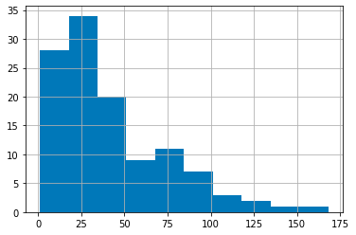
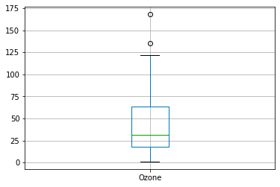
Outliers
Histogram/Box Plot:
When the feature is numeric, we can use a histogram and box plot to detect outliers.
From Histogram, if the data is highly skewed then there is a possibility of outliers and confirm with the boxplot

Slide 11
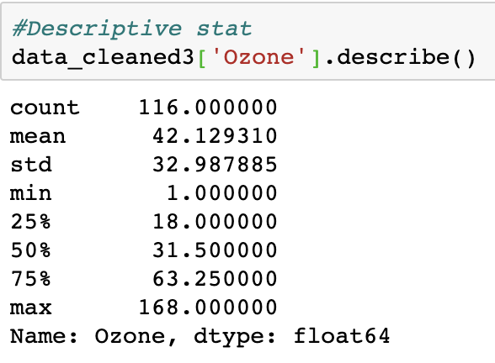
Outliers
Descriptive Statistics:
Also, for numeric features, the outliers could be too distinctive. We can look at their descriptive statistics.
For example, for the feature Ozone, we can see that the maximum value is 168, while the 75% quartile is only 68. The 168 value could be an outlier.

Slide 12
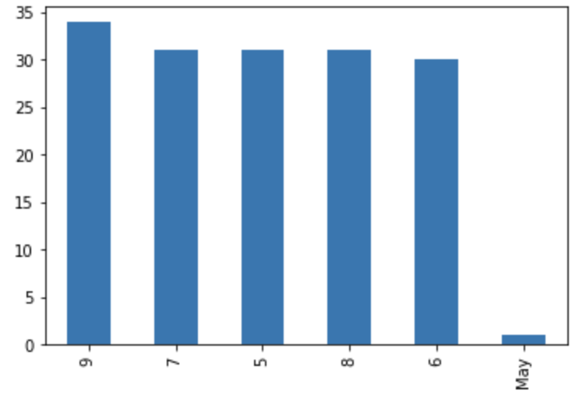

Outliers
Bar Chart:
When the feature is categorical. We can use a bar chart to learn about its categories and distribution.
For example, the feature Month has a reasonable distribution except for category 2 .
2nd Month column has only one value , this can be an outlier.
2

Slide 13
Outliers
What to do?
While outliers are not hard to detect, we have to determine the right solutions to handle them. It highly depends on the dataset and the goal of the project.
The methods of handling outliers are somewhat similar to missing data. We either drop or adjust or keep them. We can refer to the missing data section for possible solutions.

Slide 14
Data Cleaning Steps
Duplicate rows
Rename the columns
Drop unnecessary columns
Convert data types to other types
Remove strings in columns
Change the data types
Outliers

Slide 15
Refer ipython notebook for data cleaning steps

Slide 16
Missing Values:
Detection
Treatment

Slide 17
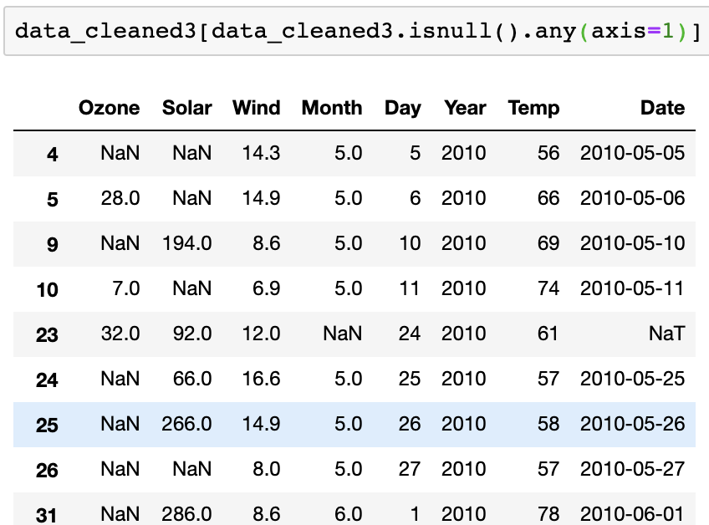
What is missing value
Some of the values will be missed in the data set because of
various reasons such as human error, machine failures etc

Slide 18
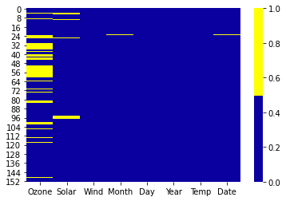
Missing Values: How to find?
Missing Data Heatmap:
When there is a smaller number of features, we can visualize the missing data via heatmap.
The horizontal axis shows the feature name; the vertical axis shows the number of observations/rows; the yellow colour represents the missing data while the blue colour otherwise.

Slide 19
Treat missing values
Drop the Observation
In statistics, this method is called the listwise deletion technique. In this solution, we drop the entire observation if it contains a missing value.
Only if we are sure that the missing data is not informative, we perform this. Otherwise, we should consider other solutions

Slide 20
Treat missing values :Impute the Missing
When the feature is a numeric variable, we can conduct missing data imputation. We replace the missing values with the average or median value from the data of the same feature that is not missing
data_cleaned3['Ozone'] = data_cleaned3['Ozone'].fillna(med)
For categorical values :
df = df.fillna(df.mode().iloc[0])

Slide 21
Treat missing values
df.method() | description
dropna() | Drop missing observations
dropna(how='all') | Drop observations where all cells is NA
dropna(axis=1, how='all') | Drop column if all the values are missing
dropna(thresh = 5) | Drop rows that contain less than 5 non-missing values
fillna(0) | Replace missing values with zeros
isnull() | returns True if the value is missing
notnull() | Returns True for non-missing values

Slide 22
Refer ipython notebook for Missing values treatment

Slide 23
Scatter Plot

Slide 24
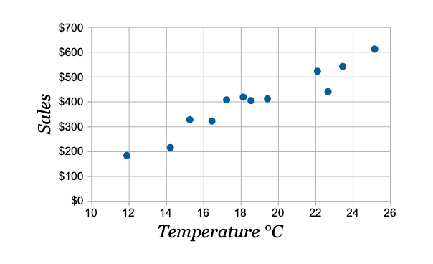
Scatter Plot
A scatter plot (aka scatter chart, scatter graph) uses dots to represent values for two different numeric variables. Scatter plots are used to observe relationships between variables.
Temperature °C | Ice Cream Sales
14.2° | $215
16.4° | $325
11.9° | $185
15.2° | $332
18.5° | $406
22.1° | $522
19.4° | $412
25.1° | $614
23.4° | $544
18.1° | $421
22.6° | $445
17.2° | $408
Which variable affects which one?

Slide 25
Scatter Plot
Cigarettes (X) in Years | Lung Capacity (Y)
0 | 45
5 | 42
10 | 33
15 | 31
20 | 29

Slide 26
Correlation

Slide 27
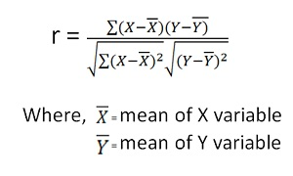
Pearson Correlation
Correlation is a bi-variate analysis that measures the strength of linear association between two variables and the direction of the relationship. Correlation is a statistical technique used to determine the degree to which two variables are linearly related.
[ -1 ….. 0 ….. +1 ]
High correlation
Low correlation
High correlation

Slide 28
Correlation r - Interpretation
Positive r indicates positive linear association between x and y or variables, and negative r indicates negative linear relationship
r – always between -1 and +1
The strength increases as r moves away from zero toward wither -1 or +1
The extreme values +1 and -1 indicate perfect linear relationship (points lie exactly along a straight line)
Graded interpretation : r 0.1-0.3 = weak; 0.4-0.7 = moderate and 0.8-1.0=strong correlation

Slide 29
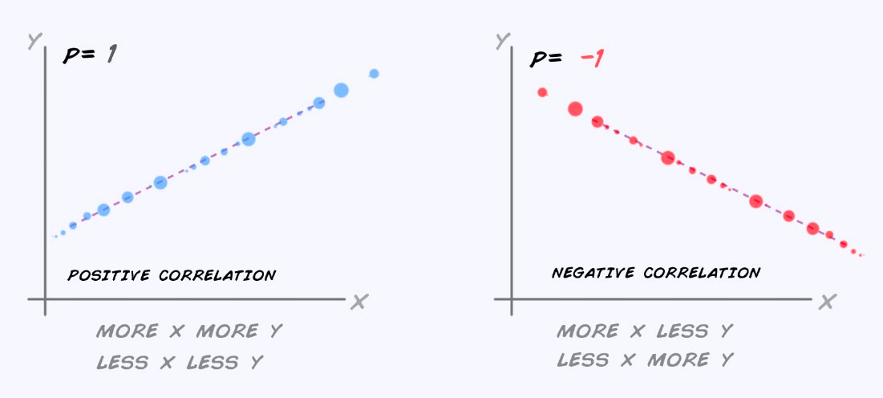
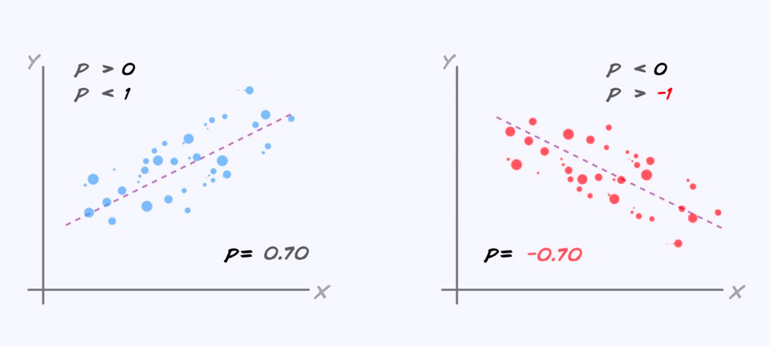
Correlation

Slide 30
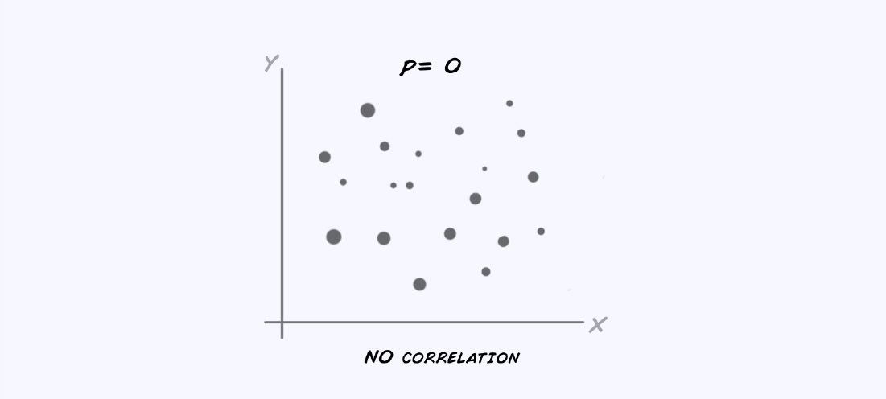
Correlation

Slide 31
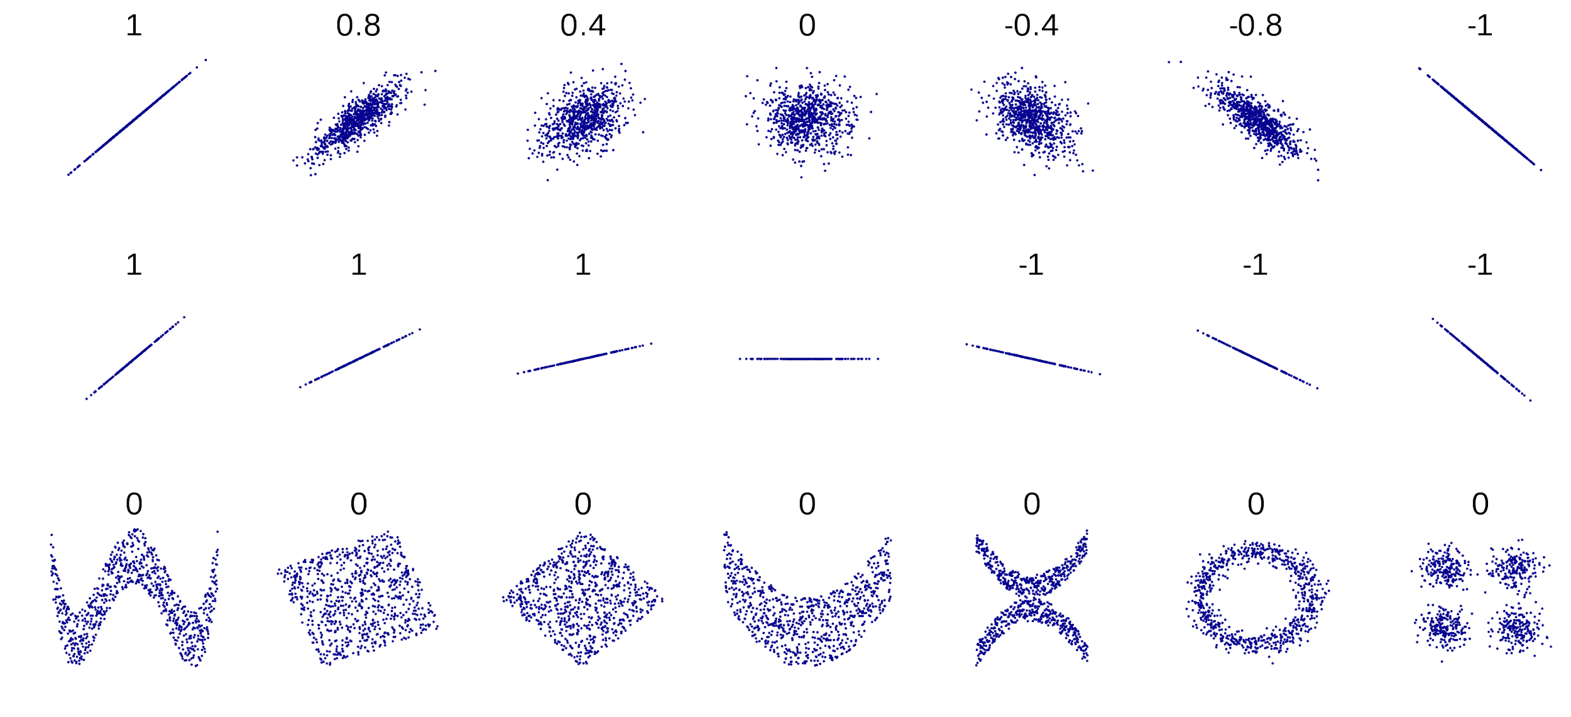
Source: https://en.wikipedia.org/wiki/Correlation_and_dependence
Non-linear association will be covered in EDA - 2

Slide 32
Scatter Plot and Correlation : Smoking and Lung Capacity
Example: investigate relationship between cigarette smoking and lung capacity
Data: sample group response data on smoking habits, and measured lung capacities, respectively

Slide 33
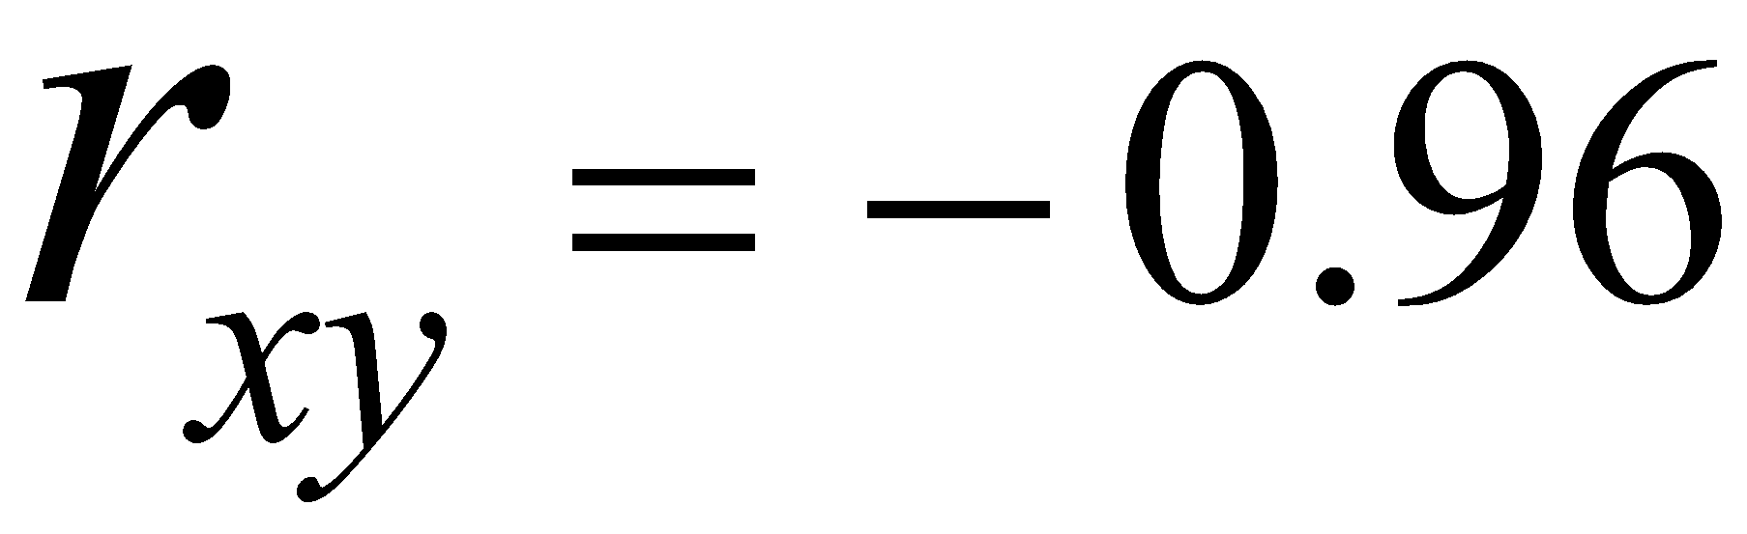
Smoking v Lung Capacity Data
N | Cigarettes (X ) | Lung Capacity (Y )
1 | 0 | 45
2 | 5 | 42
3 | 10 | 33
4 | 15 | 31
5 | 20 | 29
-0.96 implies almost certainty smoker will have diminish lung capacity

Slide 34
Transformations
Dummy Variable Feature Scaling

Slide 35
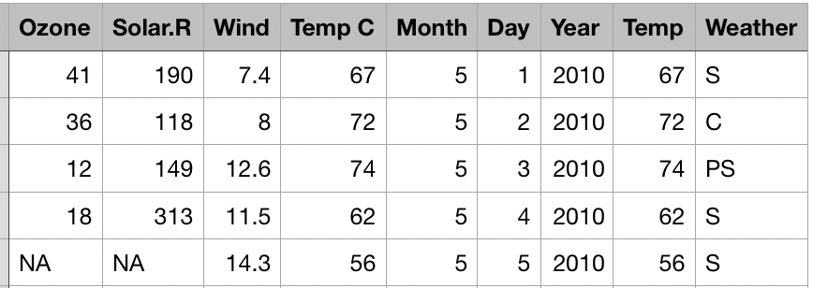
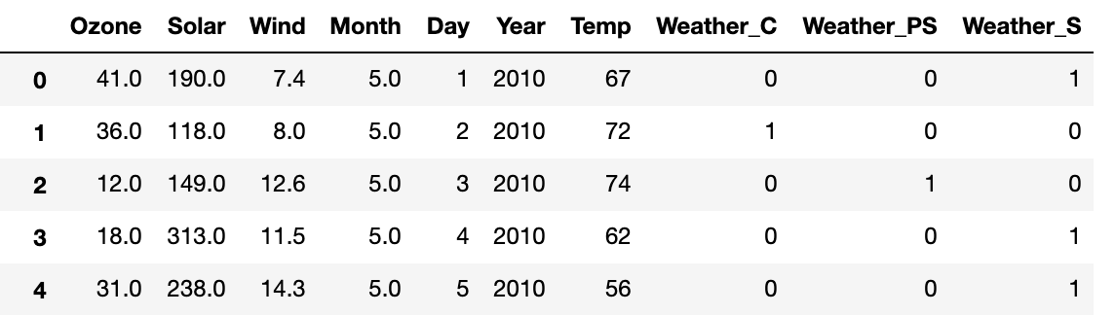
Dummy variables
Categorical variables have to be converted to numerical using a method called One-hot encoding
OHE : Pandas, sklearn
Pd.get_dummies(df)
sklearn.OneHotEncoding

Slide 36
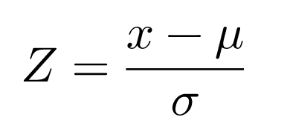
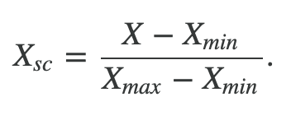
Feature scaling
Some machine learning algorithms are sensitive to feature scaling means results will vary based on the units of the features so remove of the effect of scaling, it is required to go for feature scaling
Standardization
Standardization is scaling technique where the values are cantered around the mean with a unit standard deviation.
Normalization
Normalization is a scaling technique in which values are shifted and rescaled so that they end up ranging between 0 and 1. It is also known as Min-Max scaling

Slide 37
Automatic EDA methods
Exploratory data analysis (EDA) is an essential early step in most data science projects and it often consists of taking the same steps to characterize a dataset (e.g. find out data types, missing information, distribution of values, correlations, etc.).
Given the repetitiveness and similarity of such tasks, there are a few libraries that automate and help speed up the process
Libraries:
pandas_profiling
sweetviz

Slide 38
Thank you

